Slide 1

Consultation Site for Healthcare
Group Members:
1.Ajim Sanadi(250245920075)
2.Amol Borse(250245920012)
3.Devyani Zode(250245920022)
4.Nida Kazi(250245920038)
5.Sanket Zambare(250245920099)
1

Slide 2

Introduction
The Online Healthcare Consultation System is a web-based platform designed to simplify and digitize the interaction between patients and doctors. In today’s fast-paced world, accessing timely healthcare can be challenging due to distance, busy schedules. This system aims to solve those issues by allowing patients to book appointments, consult doctors, and receive digital prescriptions from the comfort of their homes.
The system supports three main types of users:
Patients: who can register, search for doctors, and book appointments.
Doctors: who can manage their availability, consult patients, and provide prescriptions.
Admins: who monitor the overall system and manage users and appointments.
2

Slide 3
Problem Faced
Access to quality healthcare is limited in rural areas.
Urban hospitals are often overcrowded with long waiting times.
Scheduling and attending doctor appointments can be challenging due to travel issues.
Elderly individuals and those with disabilities face even greater difficulty reaching medical facilities.
Many people are unaware of the right doctor or specialist to consult for their condition.
3

Slide 4







Solution
Online Doctor Access for Villages
No Long Queues
Easy Appointment Booking
People in rural areas can connect with doctors online through chat consultations, reducing the need to travel far.
The site allows users to book appointments online, avoiding long lines and crowded hospitals in cities.
Patients can easily choose a time that suits them, and receive reminders so they don’t miss their appointments.
Support for Elderly & Disabled
Doctor Matching Feature
24/7 Availability
Elderly and disabled patients can consult doctors from home without struggling to reach hospitals.
The site can suggest the right specialist based on symptoms or health issues, so people don’t get confused about which doctor to visit.
Emergency help or general consultations can be available any time, improving access to healthcare.
Medical History & Reports Online
Patients can upload and store their medical records, which doctors can review during consultation—saving time and improving diagnosis.
4

Slide 5

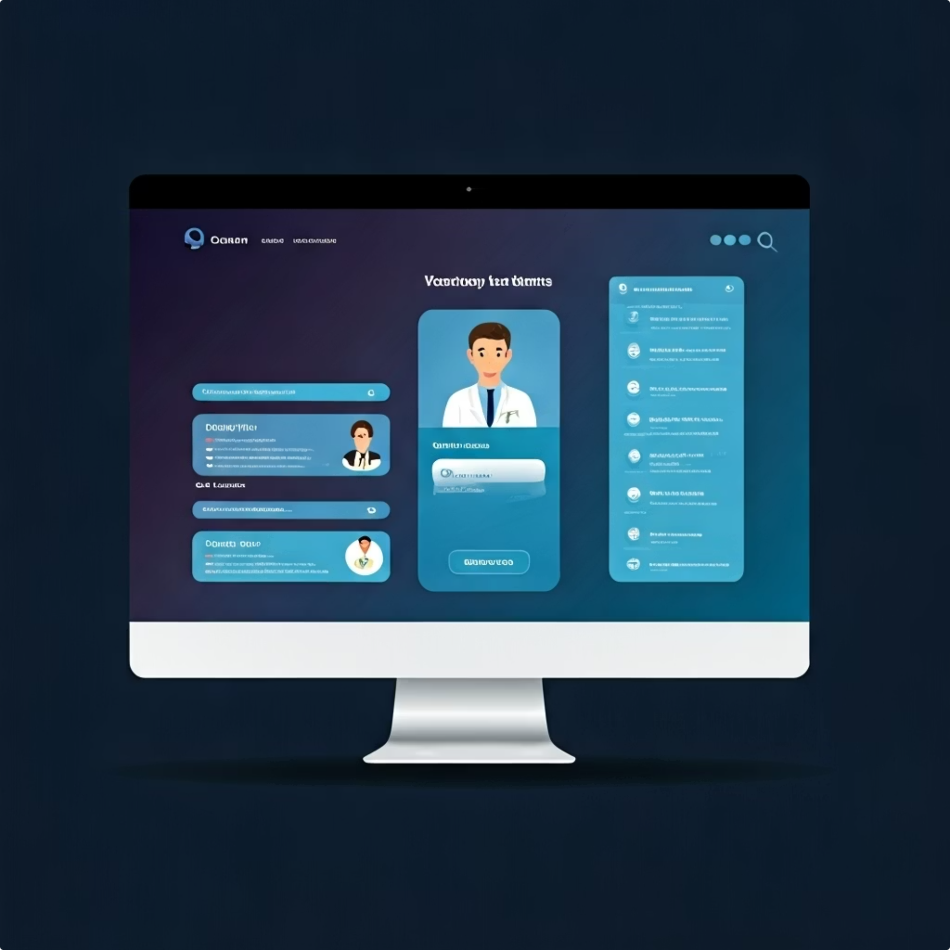
Goals/Objective
Develop a user-friendly web platform for online consultations.
Allow patients to search for doctors based on specialization and availability.
Enable secure appointment booking and chat-based consultation.
Provide doctors with features to manage schedules and issue digital prescriptions.
Allow administrators to manage users and monitor activities.
5

Slide 6
Features
24/7 Availability
Faster Response from Specialist Doctors
Secure And Confidential Communication
Comfort And Convenience
Saves Travelling Time/Costs
Reduces Waiting Time
Easy Appointment Booking
Quick Interaction With Doctor
Hygienic and safe
No Disruption to Daily Routine
6

Slide 7
H/W Requirements & S/W Requirements
Hardware Requirements:
Software Requirements:
Processor: Intel i3 or higher
Operating System: Windows 10
RAM: 4 GB minimum
Backend: .NET Core
Frontend: React.js
Database: Microsoft SQL
Tools: Visual Studio ,VS Code, Git , GitHub
7

Slide 8





Patient Workflow
Patient Login
Patient Search for Doctor
Patient Books Appointment
Patient Will Consult with Doctor
Patient Gets Prescription
8

Slide 9



Doctor Workflow
Doctor Login
Doctor Checks Appointment and Attends Appointment
Doctor Prescribes
9

Slide 10
Admin Workflow
Login
Overlook
10

Slide 11
Entity-Relationship Diagram (ERD)
11

Slide 12
Class Diagram
12

Slide 13
Use Case Diagram
13

Slide 14
Data Flow Diagram
14

Slide 15
Thank You
15

